Slide 1

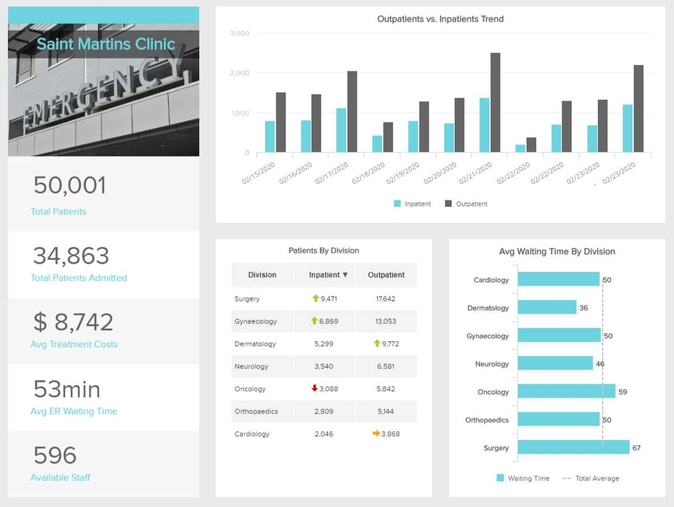


Real-time Business Intelligence
Problem statement and
solution proposal

Slide 2
Outline
The Concept
Business Use Cases
Industry Solution
Our Approach

Slide 3
The Concept
Notes:
Now my colleague Mohamed Almshargy will take you through the concept of what real time BI is and how it is being applied

Slide 4
Concept Statement
What is Real-time BI?
Up-to-date analytics
Instant data analysis
Crucial business decisions
Notes:
Real time BI is an approach in data analytics where users get up to date information and/or data for crucial business decisions. This information is being updated up to a minute in real time.

Slide 5
What enterprises need today
Why Real-time BI?
High concentration of data with more time available
Up-to-date actionable insights
Capturing time sensitive opportunities
Early detection for critical issues

Slide 6

Yesterday’s Data is No Longer Sufficient
DATA WAREHOUSING
Cost reduction
Increase sales and profits
HOWEVER
Business applications need more competitive advantage
1
“We cannot solve our problems with the same thinking we used when we created them”
-Albert Einstein
Notes:
Data warehousing solves a strategic need of the enterprise but lacks value for immediate need.
Data warehousing primary value is in supporting strategic goals such as reducing costs, increasing sales, and improving profits.
However, now we need a system with a consolidated real-time view of the business across the enterprise enables the provision of new business services (applications) which were previously impossible, achieving competitive advantage to solve our business needs.

Slide 7
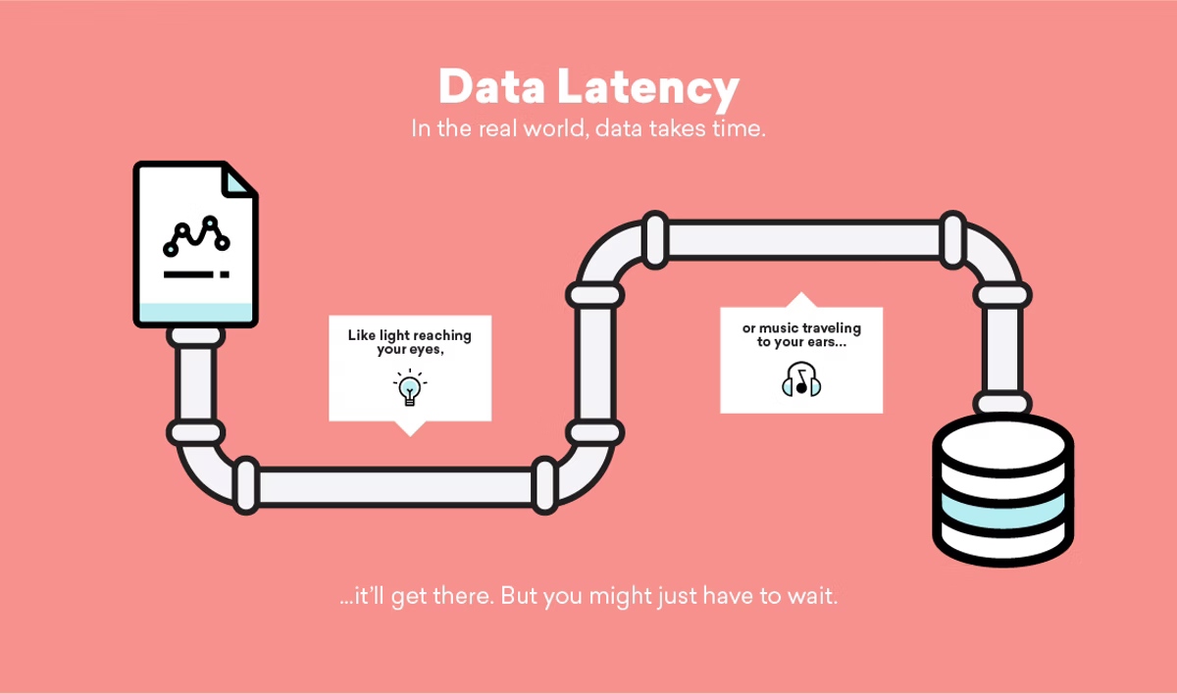
RTBI:
Data Latency
The speed of today’s processing systems has moved classical data warehousing into the realm of real-time.
Notes:
The speed of today’s processing systems has moved classical data warehousing into the realm of real-time.
Data latency provides precise on-the-spot decisions (real-time decision support), thus the freshest data and the fastest response times are needed.

Slide 8
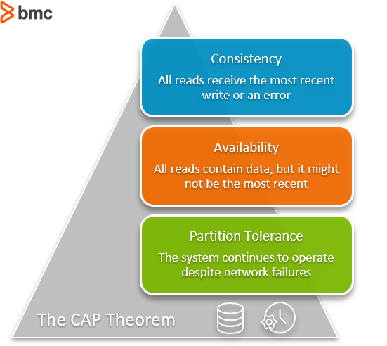
RTBI:
Data Availability
Data unavailability is a death knell for businesses. They have progressed to the point that they are dependent on RTBI, data unavailability from a failed system could bring operations to a halt, so extreme availability of the RTBI services is paramount.
Notes:
Data unavailability is a death knell for businesses. They have progressed to the point that they are dependent on RTBI, data unavailability from a failed system could bring operations to a halt, so extreme availability of the RTBI services is paramount.
If the problems of data availability is solved, businesses can react proactively to new information and knowledge rather than reactively

Slide 9
Business Use Case
Notes:
Now my colleague Vivian will take you through a few business use cases

Slide 10

Use cases for Real-time BI
Tesco
Patient Safety Game
American Express
Canada Revenue Agency
Notes:
Big Data At Tesco: Real Time Analytics At The UK Grocery Retail Giant
How Real-Time Data Can Change the Patient Safety Game
“Continuous clinical surveillance solutions, or tools that use real-time patient data to identify the early onset of patient deterioration, can help clinicians do just that.”
American Express (AMEX) has harness the power of real-time BI analytics to better serve its customers.
“By leveraging the transaction data on both the customer and merchant side in real-time, Amex used analytics to build algorithms that help to provide customized offers to attract new customers and retain existing users.”

Slide 11
American Express (AMEX)
$1.82 trillion by 2024
Notes:
The credit card industry is forecasted to reach $1.82 trillion in annual volume by 2024.
Real-time BI

Slide 12

AMEX Solution
100m credit cards
Over $1tr in charge volume
Follow a closed loop system
Analyze trends and information
Customized offer for target marketing
Notes:
With a database of over a 100 million credit cards globally, that account for over $1 trillion in charge volume every year, American Express deals with vast quantities of data. In 2010, American Express decided to leverage big data to take advantage of this huge proprietary asset to deliver innovative products in the payments and commerce space that provide value to customers.
Amex follows a closed loop system as compared to Visa and Master Card wherein it issues its own cards through its banking subsidiaries, acting as both the issuer and acquirer. Its revenue model is spend-centric targeting affluent customers rather than on transaction volumes which explains the average AmEx purchase of $150, vis-a-vis the average Visa transaction of $50. AmEx is thus, able to analyze trends and information on cardholder spending and build algorithms to provide customized offers to attract and retain customers and leverage this information to maintain relationships with merchants using targeted marketing to match merchants with the right customers, who are likely to spend more and stay loyal.
HOW??

Slide 13

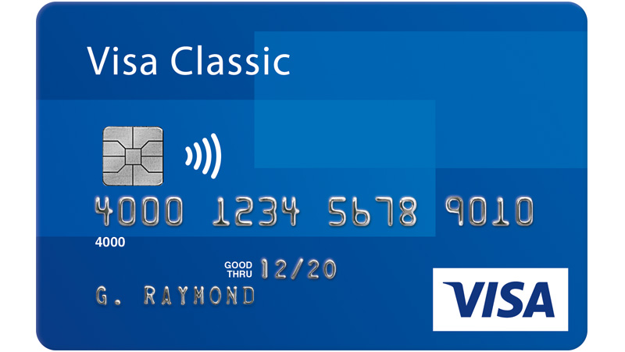
VISA vs AMEX
Notes:
Visa's clients are primarily banks and financial institutions, known as issuers, who issue cards bearing the Visa logo to their customers. When a cardholder uses a card to purchase goods or services from a merchant, information is sent via Visa's network to the merchant's bank, known as the acquirer. This is an open-loop system involving five parties: the issuer, the card holder, financial clients, merchants and banks. Thus, it is not exposed to any credit risk and earns revenue on the volume of transactions carried out through its cards.
American Express , on the other hand, issues its own cards through its banking subsidiaries, American Express Centurion Bank and American Express Bank, FSB and employs a closed-loop network, acting as both the issuer and acquirer. The company's primary source of revenues is the discount fee charged to merchants who accept its cards. These fees are charged as a percentage of the charge amount processed for the merchant and account for 65% of the company's revenues. AmEx also earns interest on loans issued to cardholders, membership fees from its cardholders and other revenues based on travel services offered. However, its revenue model does not depend on the volume of transactions processed, but rather on the total amount spent by the customer.

Slide 14
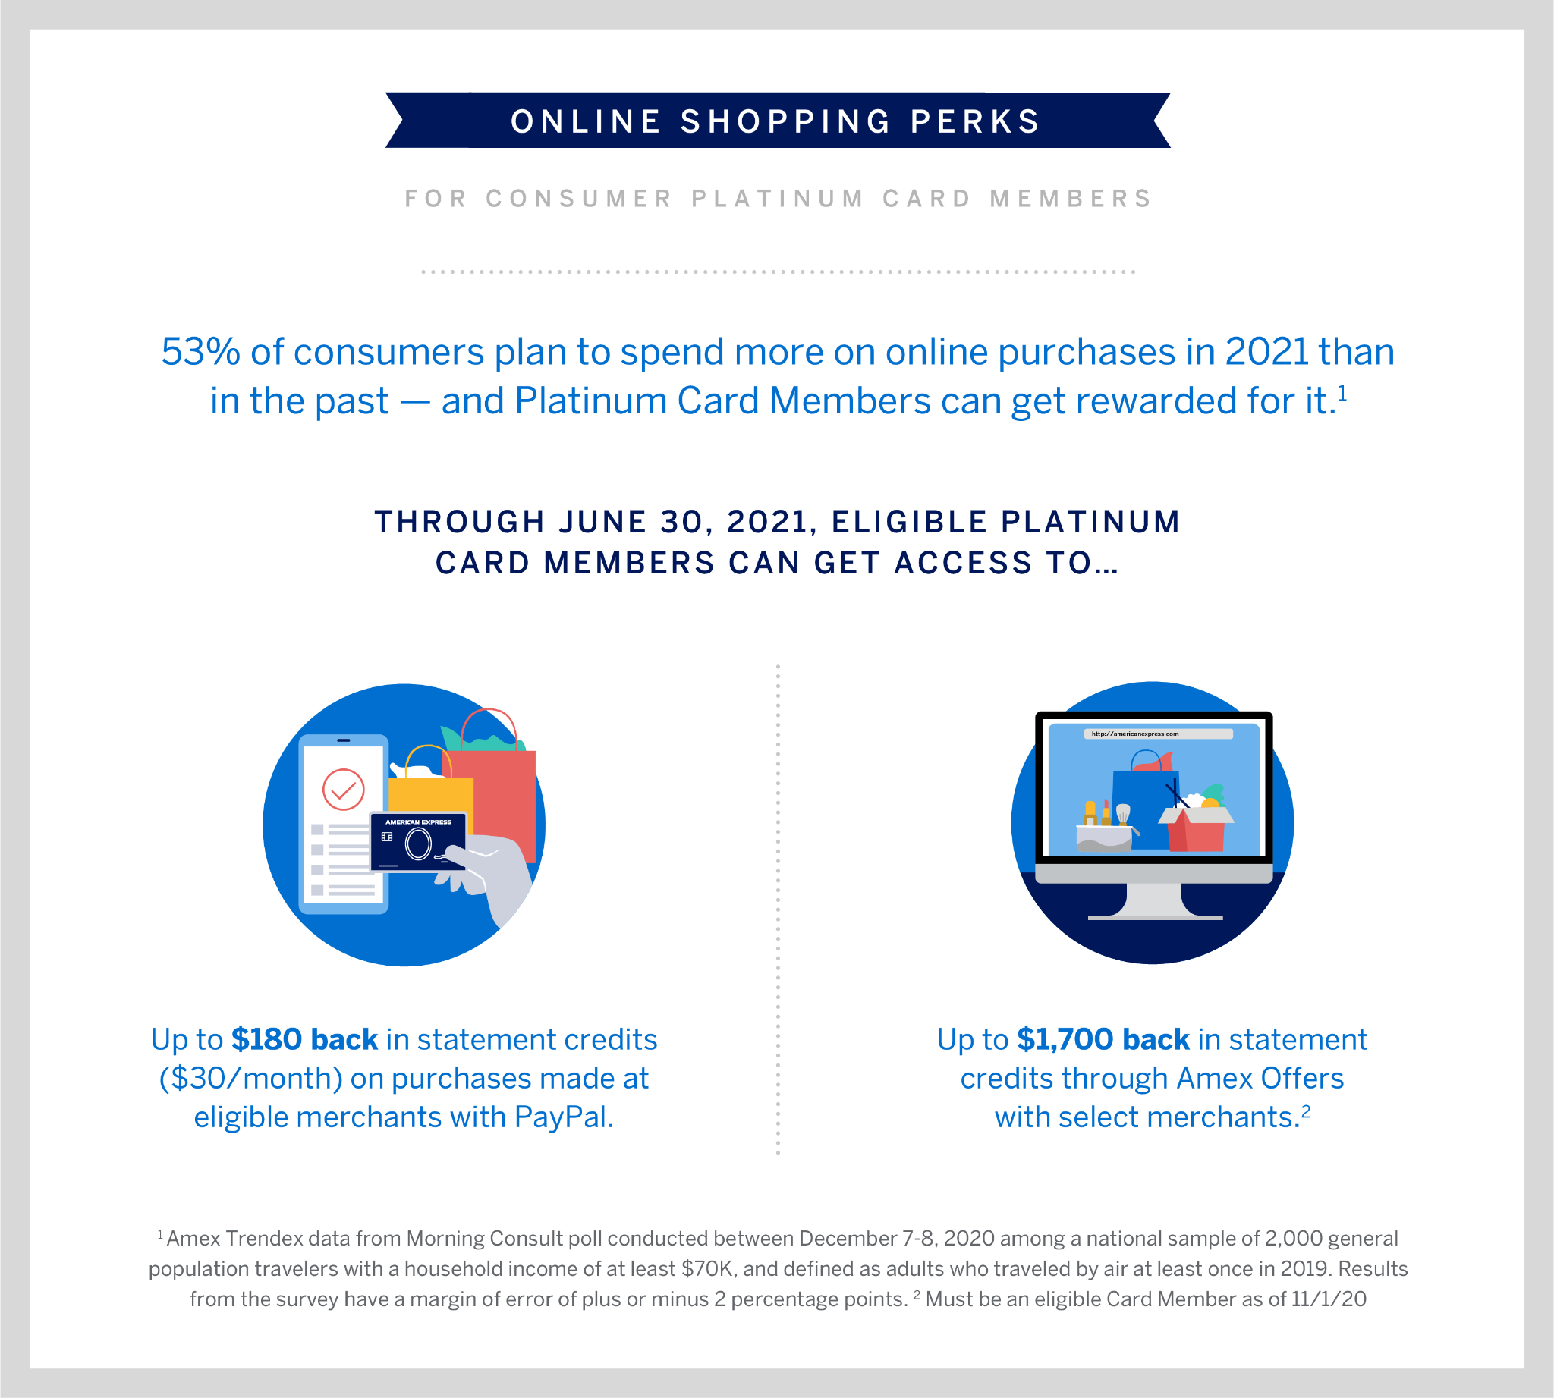
Why Would An Affluent Customer Go For American Express Over Any Other Card
Customized offers
Loyalty
Better incentives
Notes:
AmEx is able to analyze trends and information on cardholder spending and build algorithms to provide customized offers to attract and retain customers.
Leverage the information provided by its network to maintain relationships with merchants using targeted marketing to match merchants with the right customers, who are more likely to spend more and stay loyal.
AmEx offers rewards to incentivize higher spending and also offers value added services
According to the 2010 U.S. census, around 22% of households in the country earn more than $95,000 per year and forecasted to grow in the future.

Slide 15
Canada Revenue Agency (CRA)
$280.8bn in tax revenue

Slide 16
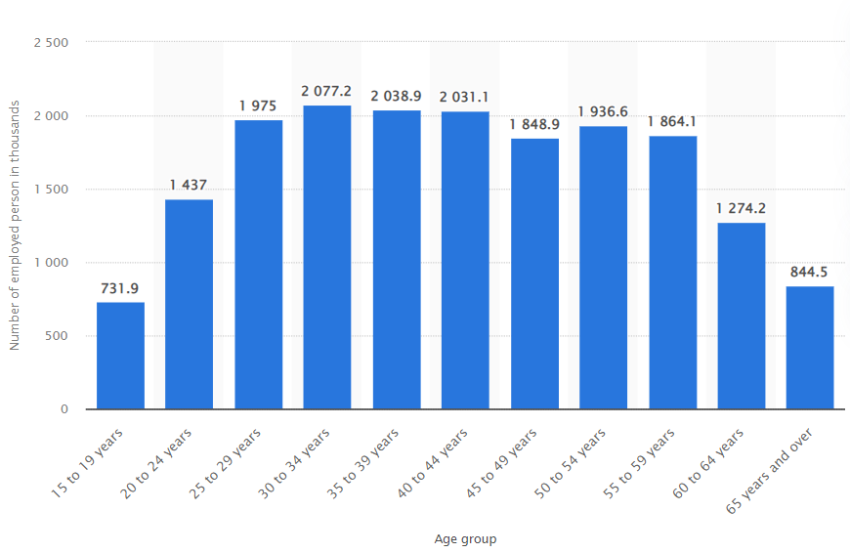
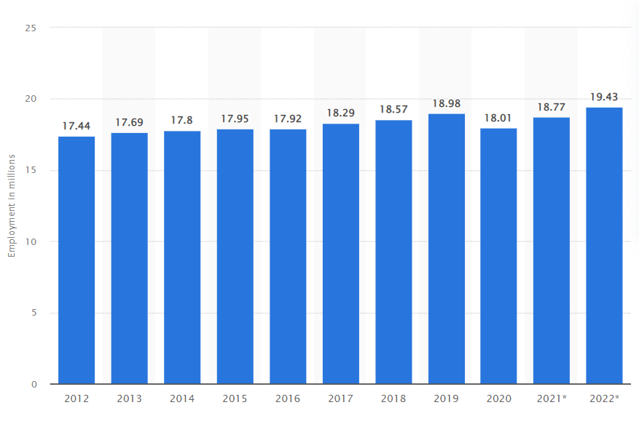
CRA Scenerio
Notes:
There are 19,43 million workers in 2022
Each employee needs 2 T4 slips
In the workforce, those who are under 20 and close to retirement are more likely to work 2 part-time jobs
If an employee working part-time for 2 employers, the pay slip will take a lot of time to process
Thus, a lot of mistakes can be made and the regular data warehouse can’t store and process information effectively. This is where Real-time BI comes in

Slide 17
Real-time BI Solution
With real-time updates, instead of manual inputs that take months and weeks, T4 slips could be sent in an instant

Slide 18
Tools & Industry Solution
Notes:
Now my colleague Mohamed Raafat will take you through tools and industry solution

Slide 19
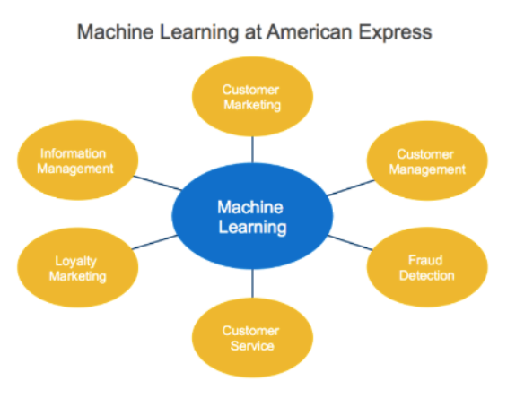

AMEX Approach
Component Browser
Fraud Detection
New customer acquisition
Comprehensive digital strategy
Balsamiq Tip | Use the Balsamiq add-on to make your own wireframe.
Notes:
Fraud Detection: To detect fraudulent transactions quickly so as to minimize loss, the company employed a machine learning model that uses various inputs like card membership information, spending details, and merchant information which are pattern-matched against evolving algorithms in real time to flag transactions that have a high probability of being fraudulent. This has added a precision of milliseconds to the system’s predictive capabilities. According to estimates by the company, the approach has identified $2 billion in potential annual incremental fraud incidents, which the company was able to sort out before any money was lost.
New Customer Acquisition: The use of web and targeted marketing through machine learning models, has resulted in a 40% rise in new customer acquisition via online interactions as opposed to 90% of new customers that were acquired through direct mail campaigns reducing costs.
Challenges & Opportunities: The need to create a comprehensive Digital Strategy
The ongoing challenge that the company faces is balancing big data investment between immediate needs and research that will drive the next generation of capabilities. Also, for AmEx there were privacy and regulatory challenges which governed which data could be used.
Going forwards, the challenge for AmEx is to avoid using its data advantage solely to drive traditional marketing, and aim for more than an increase in consumer spending. Its competition now is with the Fintech startups that are changing the way payments are made. It should work towards creating an AmEx internet platform to integrate all their services, while driving internal efficiencies and cost reductions. Realizing this AmEx has increased its social media engagement. It has also introduced a prepaid payment card Serve, supporting peer-to-peer payments and a Facebook app to pay friends directly from the FB wall. With its outstanding track-record in security and personalized transactions AmEx has built an enviable brand value which it can leverage as it undertakes a digital transformation.

Slide 20
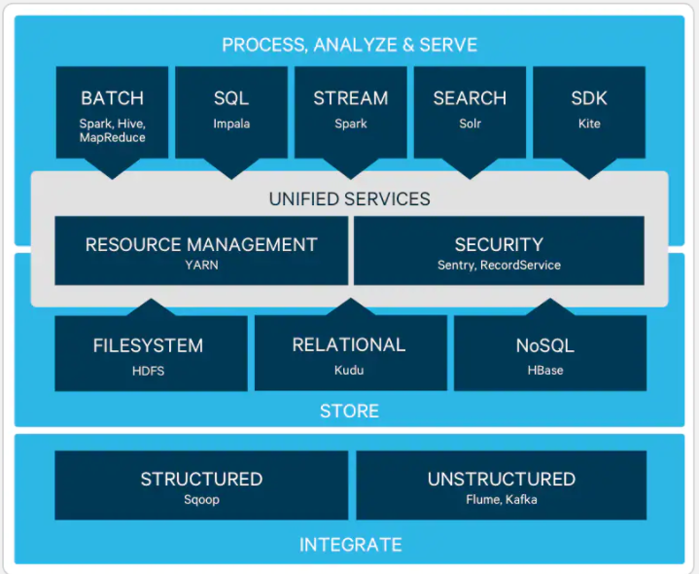
Component Detail
Notes:
The Apache™ Hadoop® project develops open-source software for reliable, scalable, distributed computing.
The Apache Hadoop software library is a framework that allows for the distributed processing of large data sets across clusters of computers using simple programming models. It is designed to scale up from single servers to thousands of machines, each offering local computation and storage. Rather than rely on hardware to deliver high-availability, the library itself is designed to detect and handle failures at the application layer, so delivering a highly-available service on top of a cluster of computers, each of which may be prone to failures.
The Hadoop platform indeed provides the ability to efficiently process large-scale data at a price point we haven’t been able to justify with traditional technology. That said, not every technology process requires Hadoop; therefore, we have to be smart about which processes we deploy on Hadoop and which are a better fit for traditional technology (for example, RDBMS). Some components of the ecosystem are mature and work well, and others require some engineering to get to an enterprise-ready state. In the end, it’s an exciting journey to offer new innovation to our business.

Slide 21
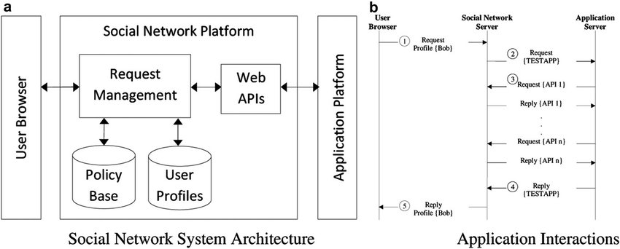
Component Detail (Mobile)
Notes:
The major social media networks all have APIs. While you are prohibited from using them to duplicate the company’s core service and sell that as your software, you can build on them to improve the experience.
But APIs also limit you in what you can do, and this isn’t always due to a flaw in the software, but rather a limit to the capabilities of the API. For example, you can’t schedule Instagram posts to upload and post on your behalf while you’re sleeping unless you use a tool like Sprout Social.

Slide 22
Our Approach
Notes:
Now my colleague Mirna will take you through our approach and the technology used for our capstone project

Slide 23
Technology
Python (Twint, Pandas and NumPy)
Microsoft Power BI
Twitter API

Slide 24


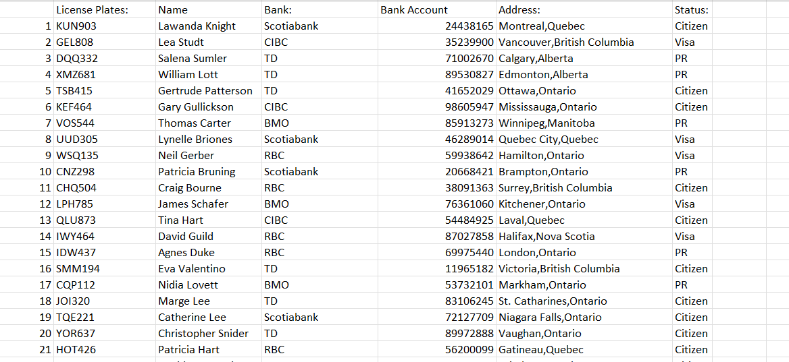
Dataset
Notes:
Python (Twint, Pandas and NumPy)
Twitter API

Slide 25
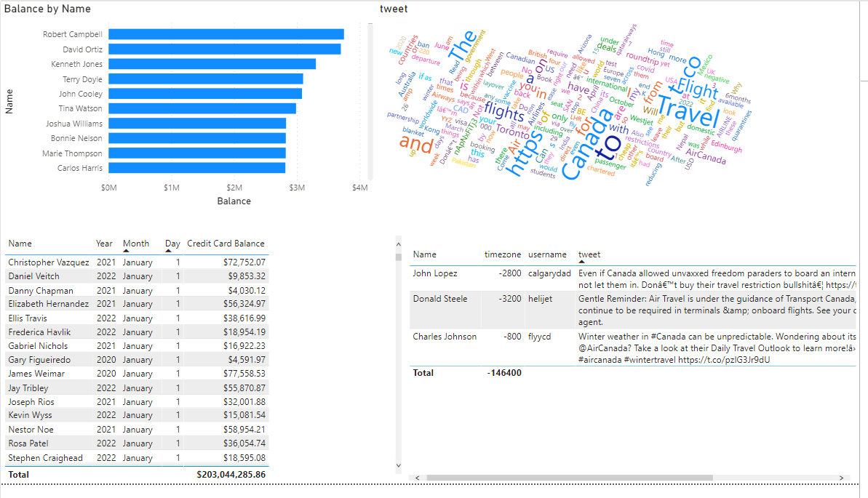


Visualization
Notes:
Microsoft Power BI

Slide 26
References
How American Express Gains A Competitive Advantage From Its Closed-Loop Network
Google Images

